Slide 1
NAME: AJITHKUMAR M DEPT: B.TECH(Artificial Intelligence and Data Science) REGISTER NO: 821721243007 COLLEGE: Sir Issac Newton College of Engineering and Technology
Final Project
3/21/2024 Annual Review

Slide 2
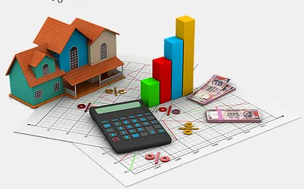
House Price Prediction Using ML
3/21/2024 Annual Review

Slide 3


AGENDA
Here's an agenda for a house price prediction project using ML:
Introduction
Data Acquisition and Preprocessing
Exploratory Data Analysis (EDA)
Feature Selection
Model Evaluation
Deployment and Future Considerations
Conclusion
3/21/2024 Annual Review

Slide 4

PROBLEM STATEMENT
Prices of real estate properties are sophisticatedly linked with our economy.
Despite this, we do not have accurate measures of house prices based on the vast amount of data available.
Proper and justified prices of properties can bring in a lot of transparency and trust back to the real estate industry, which is very important for most consumers especially in India.
Real estate is not only the key sector of the national economy, but also one of the citizen's major concerns.
With increasing demand of housing, prices of houses are also going up.
It is critical to provide accurate predictions of housing prices.
3/21/2024 Annual Review

Slide 5

PROJECT OVERVIEW
House Price Prediction using Machine Learning aims to forecast the selling prices of residential properties based on various features such as location, size, amenities, etc. By leveraging algorithms like linear regression or decision trees, the model learns patterns from historical data to provide accurate price estimates. This project facilitates informed decision-making for buyers, sellers, and real estate professionals, enhancing efficiency in the housing market.
Our project aims to predict house prices using machine learning techniques. We collect and preprocess real estate data, conduct exploratory analysis, and select relevant features. Employing various machine learning models, we train and evaluate their performance using appropriate metrics. Ultimately, we aim to deploy an accurate predictive model to assist in real-world housing market analysis and decision-making processes.
3/21/2024 Annual Review

Slide 6

WHO ARE THE END USERS?
Real Estate Agents and Agencies: They can use the predictions to provide more accurate pricing estimates to their clients, facilitating smoother transactions.
Homebuyers and Sellers: Individuals looking to buy or sell properties can benefit from having access to accurate price predictions to make informed decisions about their investments.
Property Investors: Investors can leverage predictive models to assess the potential profitability of purchasing or selling properties in specific locations.
Financial Institutions: Banks and mortgage lenders can use house price predictions as part of their risk assessment process when offering loans or mortgages.
Government and Urban Planners: Municipalities and urban planners can utilize predictive models to understand housing market trends and make informed decisions about infrastructure development and urban planning initiatives.
3/21/2024 Annual Review

Slide 7

YOUR SOLUTION AND ITS VALUE PROPOSITION
Solution:
House Price Prediction Solution offers a reliable, scalable, and user-friendly platform for stakeholders in the real estate industry to make data-driven decisions, optimize investments, and navigate the housing market with confidence
Value Proposition:
House price prediction accurately empowers buyers and sellers to make informed decisions, optimizing transactions and investments. Our solution harnesses advanced machine learning algorithms to analyze comprehensive property data, delivering precise price estimations swiftly and reliably. With our platform, users gain confidence in their real estate transactions, ensuring fair deals and maximizing returns.
3/21/2024 Annual Review

Slide 8

THE WOW IN YOUR SOLUTION
Wow your clients with our cutting-edge machine learning solution for house price prediction! Our innovative platform utilizes state-of-the-art algorithms to analyze vast datasets, providing highly accurate and timely predictions. With our solution, clients can confidently navigate the real estate market, making informed decisions and maximizing their investments. Experience the power of AI-driven insights and stay ahead in the competitive housing market.
Seamlessly integrated into our user-friendly platform, our solution empowers buyers, sellers, and investors alike to navigate the housing market confidently. Stay ahead of the curve with our ML-driven approach, revolutionizing house price prediction and transforming the way real estate transactions are conducted.
8
3/21/2024 Annual Review

Slide 9
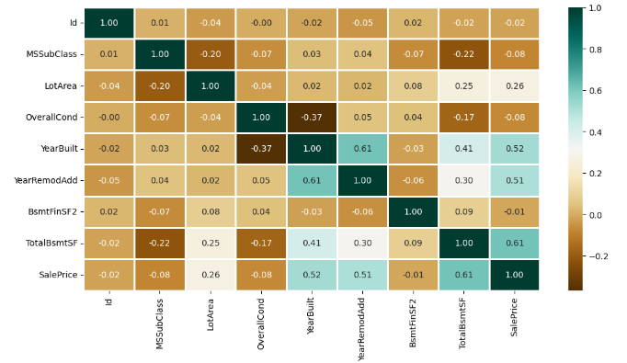
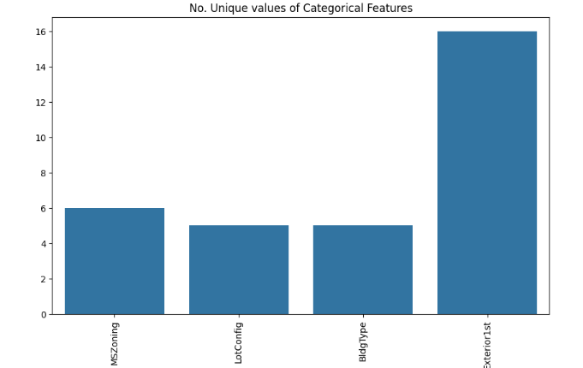
Data Visualization

Slide 10
MODELLING
In our house price prediction modeling, we employ a multi-faceted approach, combining sophisticated machine learning algorithms with comprehensive feature engineering techniques. By meticulously analyzing diverse data points such as property attributes, neighborhood characteristics, and economic indicators, we extract valuable insights to enhance prediction accuracy.
With a focus on interpretability and scalability, our solution adapts seamlessly to varying market conditions and geographical regions. Backed by robust statistical methodologies, our modeling framework ensures reliable forecasts, empowering stakeholders to make informed decisions in real estate transactions. Embrace the future of house price prediction with our innovative modeling solution, setting new benchmarks for precision and efficiency in the industry.
10

Slide 11
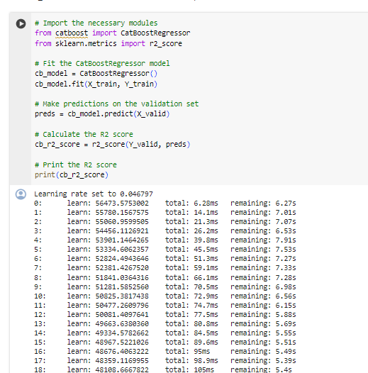
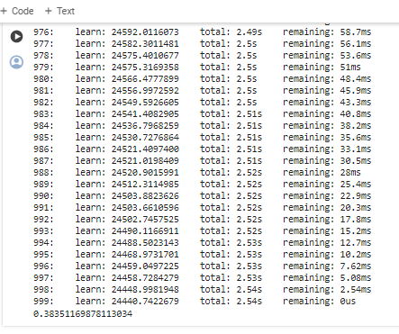
RESULTS
https://github.com/Ajithkumar337/Project_1.git
11

